Slide 1
Welcome to your Library orientation programme
Dr. Sachin S. Suryawanshi
Librarian
Bharati Vidyapeeth Deemed to be University, Pune
Abhijit Kadam Institute of Management and Social Science, Solapur

Slide 2
Purpose of Orientation
1. To ensure that library users can make use of library resources and services , adequately and to their own satisfaction.
2. Library orientation makes library users aware of the library and the services it offers. Library orientation educates people regarding general use of the library.

Slide 3
About the Library
The Library is spread over First floor with the total covered area of 6339 sq.ft. Specifies Reading Rooms with the capacity of 70 users, Stack room and Reference sections, Digital Library section, Periodicals sections etc…
Library has rich collection of documents consisting of books on Management and Computer applications . Theses, conference proceeding, journals, CD/DVD and E- Resources .
It is well equipped with Book Drop Box, Using SOUL Library Management System for Visitors Management systems and In-house library activities

Slide 4
About the Library
It has an open access system for all faculty and students as a unique feature. Institute has the membership of EBSCO, DELNET J-GATE, INFLIBNET Resources ( Shodganga ,E-Shodshindu, SWAYAM, SWAYAM Prabha, Shodhgangotri, Vidhwan, CEC-UG YOU Tube Channel,E-Content Courseware in UG Subject, PG Pathshala, UG/PC MOOC ) Online Journals and National Digital Library of India are part of our world class Digital Library.

Slide 5
Library Timings
Library Working Hours
Monday to Friday 10:00 AM to 5:30 PM
Lunch Break
1.30 to 2.00 P.M
Saturday 10:00 AM to 1:30 PM

Slide 6
Library at a Glance
Resources | No’s
Books | 23749
Journals (Current Subscription) | 48
Project Report | 600
Bound volumes of Journals | 675
CD/DVDS | 615
News Papers | 11

Slide 7
Library Services
Open Access
Circulation
Document Delivery Services
Reference Services
Book Drop Box
New Arrivals
Suggestion Box
Digital Library
Visitors Management sys tem
Online Question Papers and Syllabus
Scanning/ Printing Facility
Ask- a- Librarian
Web- OPAC
Online Reservation

Slide 8
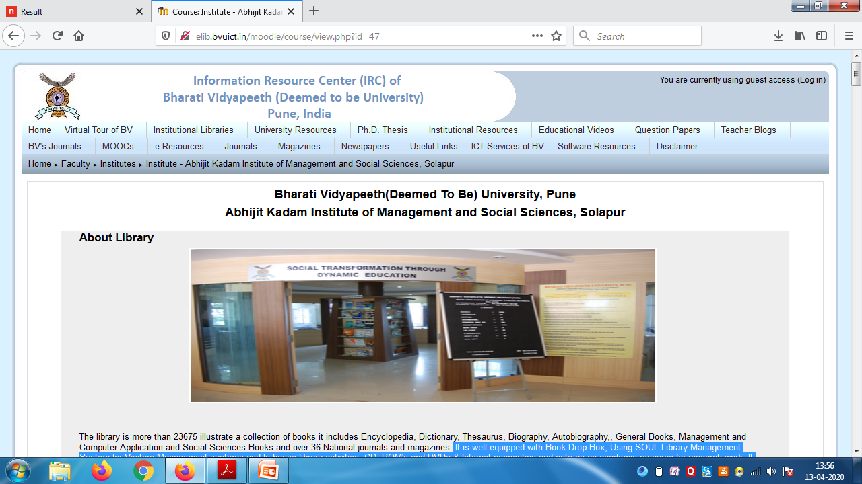
Library Web Page (http://elib.bvuict.in/moodle/course/view.php?id=47)

Slide 9
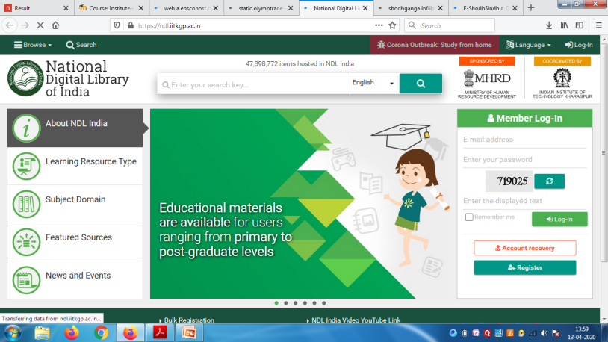
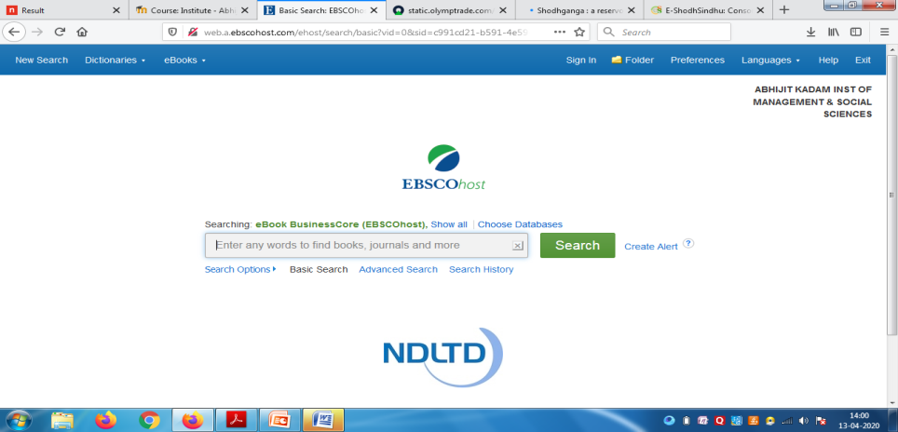
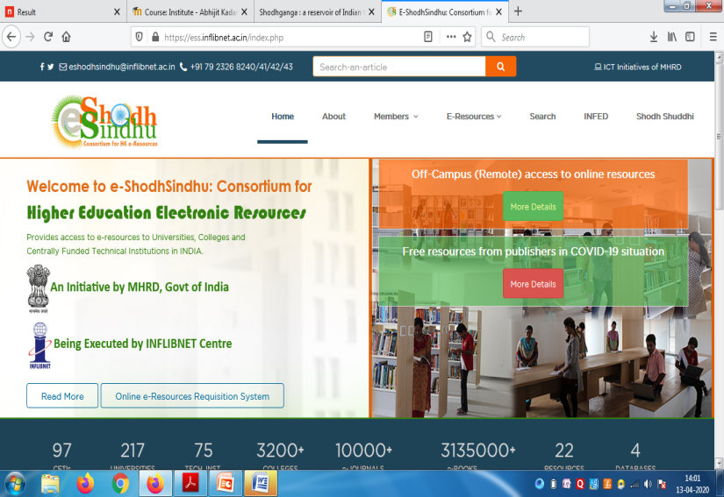
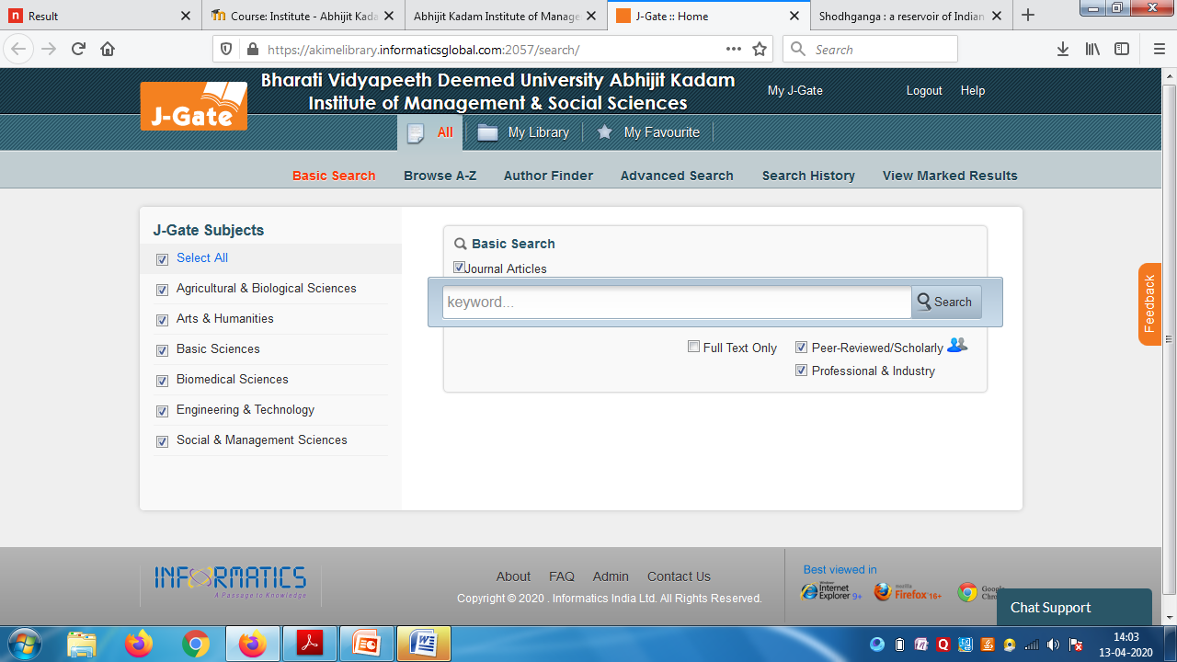
Digital Resources Access

Slide 10
How to access e-resources
Subscribed/ Free Digital E- Resources
https://www.bvuict.in/index1.html
Bharati Vidyapeeth Deemed to be University Information Communication Technology ( ICT Services)
E- Journals/ E-Books
Information Resource Center (e-Library)
http://elib.bvuict.in/moodle/
News Papers
Institutional Libraries Solapur Abhijit Kadam Institute of Management and social sciences Solapur
http://elib.bvuict.in/moodle/course/view.php?id=47

Slide 11
E- Resources
Library has subscribed following E- Resources
J-gate Plus
EBSCO e- Books
DELNET
National Digital Library ( Free Membership)
Near about 7 lack e-books and 65000 research articles are accessible through the all e-resources, 28 various national, Business / finance, Regional News paper are accessible

Slide 12
Question Papers/ Syllabus
All user can download the previous question paper and current syllabus on library web page.
Link:- http://elib.bvuict.in/moodle/course/view.php?id=47

Slide 13
How to search the Book
URL:- http://192.168.1.50/WebOPAC/main.aspx
Link:- library.bharatividyapeeth.edu
Full Procedure how to search books in OPAC is mentioned in Library
User Can access all the Previous Question, Syllabus and Various Open Access Journals. E-books on our Library web Page.

Slide 14
Library Rules (General)
Users (First Year students) should register his/ her name in the library, before 31st Aug.
Identity card and borrow card will not be issued unless original fees receipt is produced. Students ( Second/ Third Year) should renew their identity card annually before 31st July
While entering the library every student is required to enter/ Swap ID Card in VSM
. All books should be returned after the end of semester or term

Slide 15
Library Rules ( General)
Every semester Library will issue the NO DUES Certificate to all ,For the Purpose of Library NO DUES student should Submit/ Show the Borrow card and ID Card to library staff compulsorily
All the students and the members of the library are requested to extend their best co-operation all the time
Loss of library card and borrow card should be reported at once. Duplicate identity /Borrow card will be issued but if any misuse is detected on the original card the student will be held responsible for it. For duplicate identity Rs. 50/- and borrow card Rs. 25/- will have to be paid.
If any student is loss the library books they should report to library staff. Student should recover the book by giving fine or by giving same book to library .

Slide 16
Borrowing Facility
Library has issued 2 borrow cards per year and two books are issued for 7 days period. Student can renewal these books 2 times ( If the student has submitted the book to the library after the due date library will charge the 5/- Late fee per day)
Periodicals / Project report / Question paper / Reference books / Bound volumes of journal and News paper will be given on the ID Basis for their reference for one day or make a photocopy of these material.( if they not submit these materials in given time , Library will charge 10/- as late fee per day)

Slide 17
Feedback
If any kind of queries/ suggestions about library u can drop the suggestion in suggestion box or write E- mail to LibrarianAkimss1981@gmail.com
Feedback form is available in our Library web Page your feedback is most important to further improvement

Slide 18
Thank you

